Slide 1
BOOK
Buy Online Old Kitab
By:
Rajshri totla

Slide 2
INTRODUCTION
E-Commerce website
Business Idea: To provide a platform to sell old books
Books of all kinds and quantity

Slide 3
PROJECT DESIGN
Conceptual design can be divided into two parts:
Data model
Process model

Slide 4
Data model
PayPal / Credit Card
has
Customer
has
Inventory
has
has
has
has
Order Details
Shopping Cart
Wishlist
Shipping Type
has
Purchase History

Slide 5
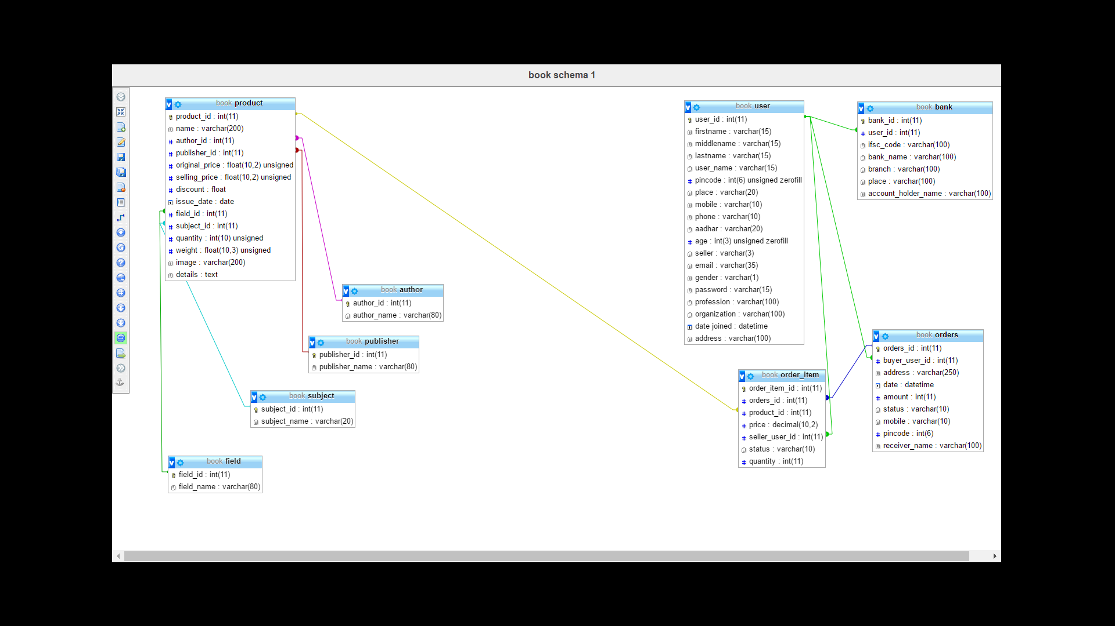
Database design

Slide 6
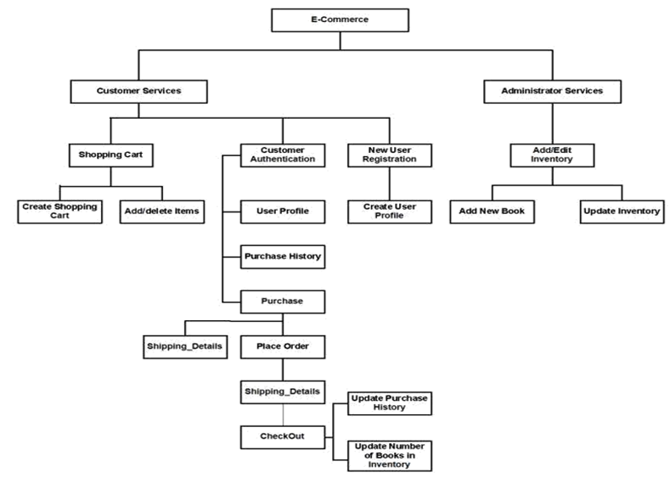
Process Model
Image Source: http://webocreation.com/blog/wp-content/uploads/2012/11/Untitled-10.jpg

Slide 7
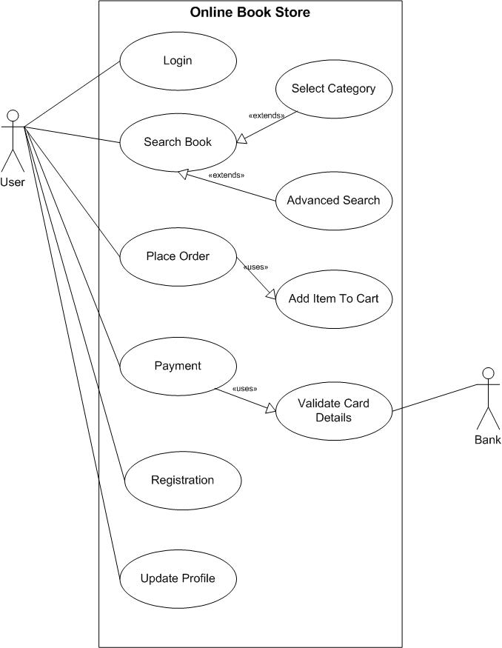
Use case diagram
Image Source: https://1.bp.blogspot.com/-XGk4MTUJoUw/UUC0_4ypQwI/AAAAAAAAAVs/5ycu6CA1vng/s1600/use+case+(user).jpg

Slide 8
Implementation technologies
XAMPP
PHP
MariaDatabase
PayPal
IDE: NetBeans

Slide 9
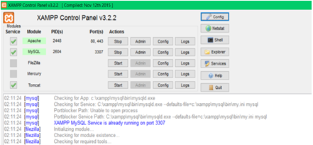
XAMPP
Stands for
  Cross-Platform (X)
  Apache (A)
  MariaDB (M)
  PHP (P)
  Perl (P)
Free and open source web server

Slide 10
PHP
PHP: Hypertext Preprocessor
Server side scripting language
Characteristics
  Simplicity
  Efficiency
  Security
  Flexibility
Prerequisite
  Web server
  Database
  PHP Parser

Slide 11
Maria database
Includes high-performance storage engines, for working with other RDBMS data sources
Runs on a number of operating systems
Supports a wide variety of programming languages.
Offers many operations and commands unavailable in MySQL

Slide 12
Web application
Website consists of the following web pages:
404login.php
404register.php
account.php
book_selling_form.php
cart.php
check_availability_of_user_name.php
check_login.php
checkout.php
contacts.php
do_register.php
footer.php
header.php
header_when_session.php
home.php
include_in_all_afps.php
left_sidebar.php
login.php
logout.php
order.php
paypal.php
product_details.php
register.php
registration_successful.php
select_author.php
select_field.php
select_publisher.php
select_subject.php
shop.php
update_quantity_in_cart.php
user_id_available.php
wishlist.php

Slide 13
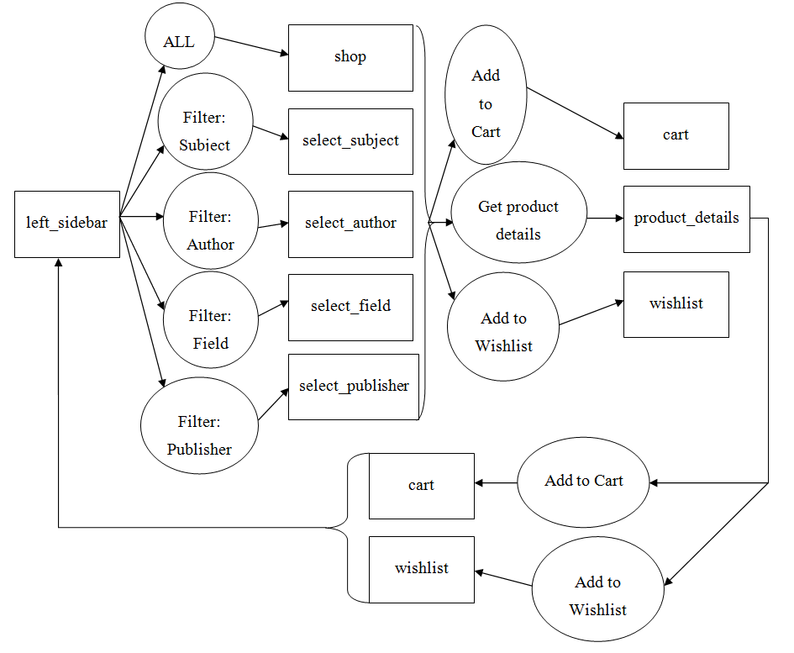
Browse a book

Slide 14
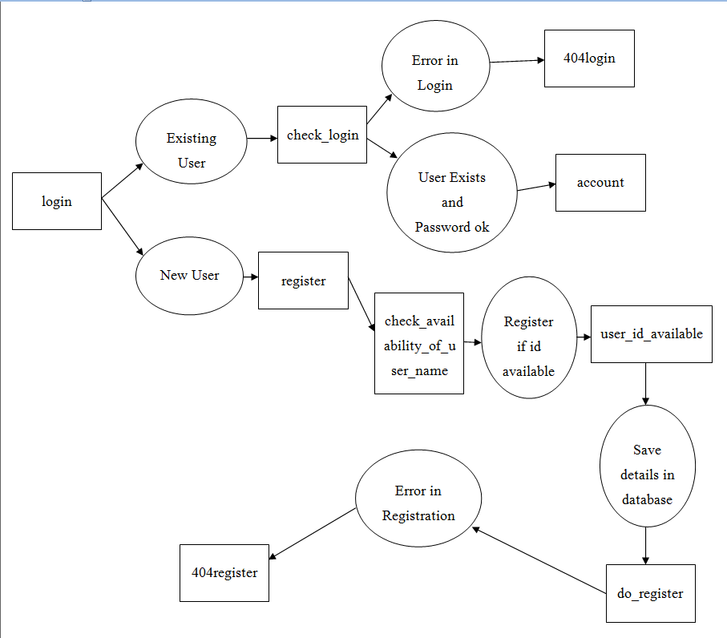
login

Slide 15
User interfaces

Slide 16
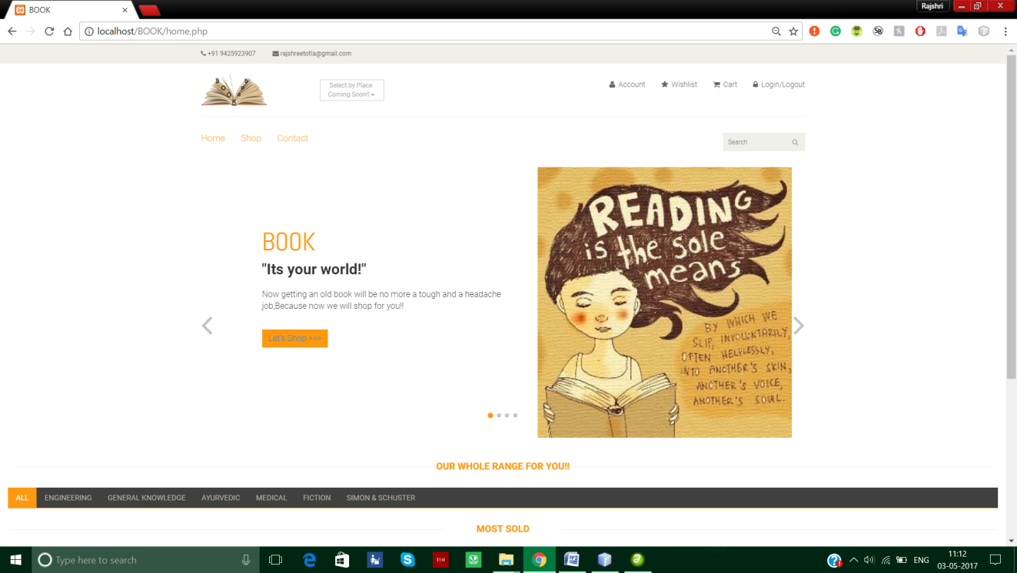
home

Slide 17
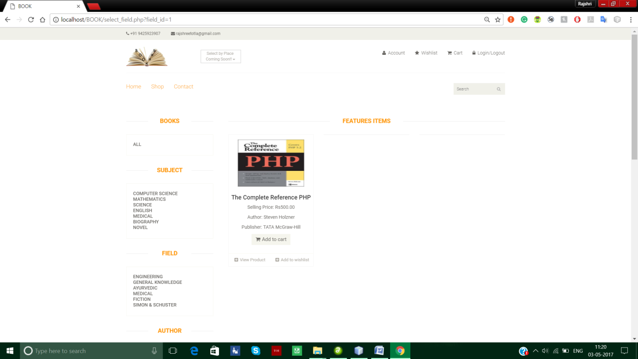
filter by field

Slide 18
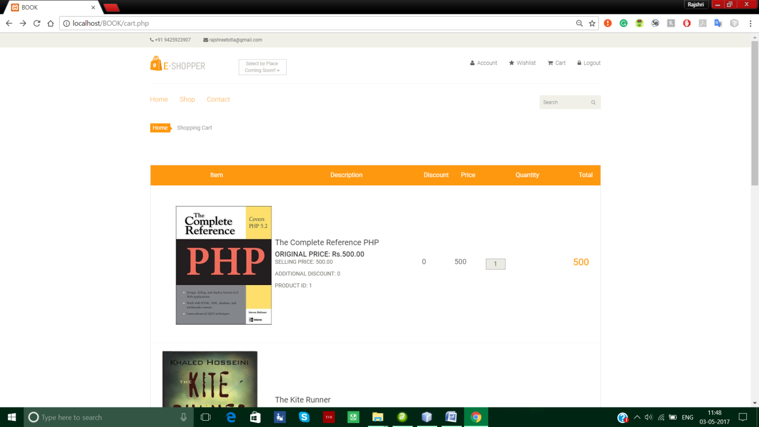
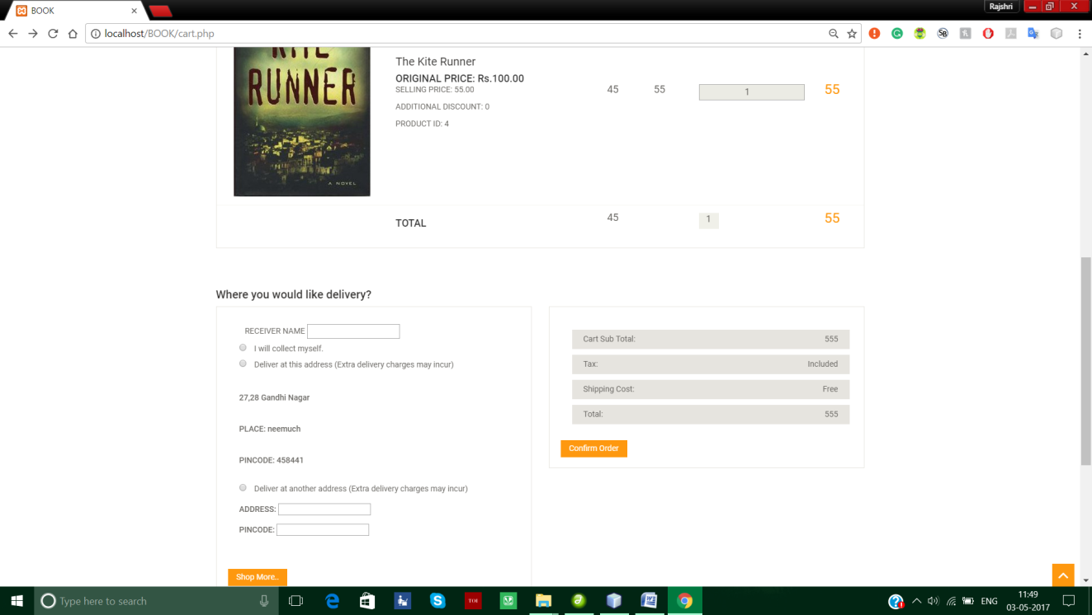
cart

Slide 19
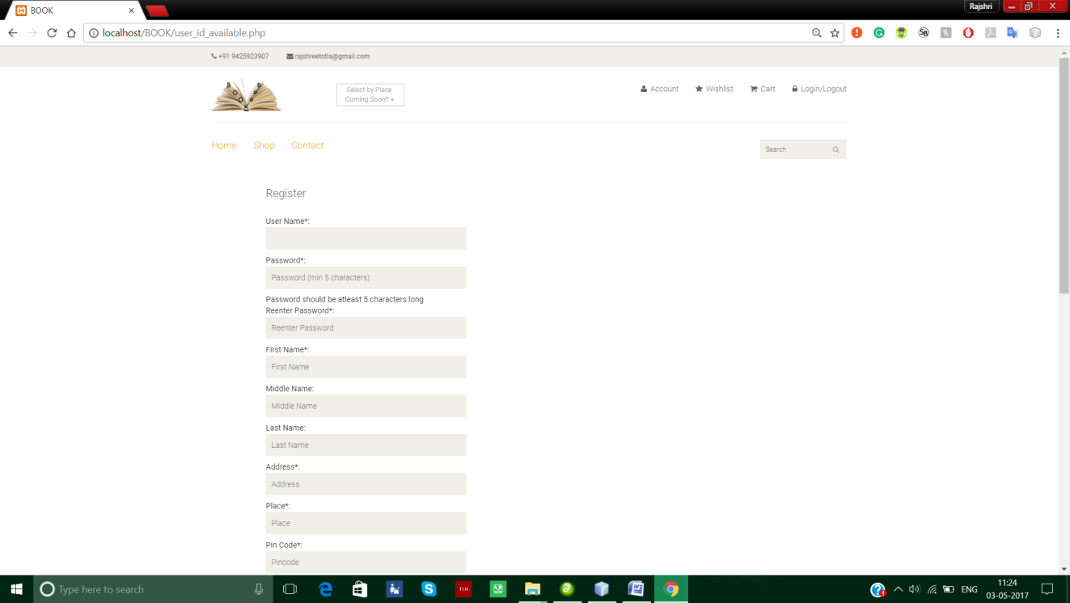
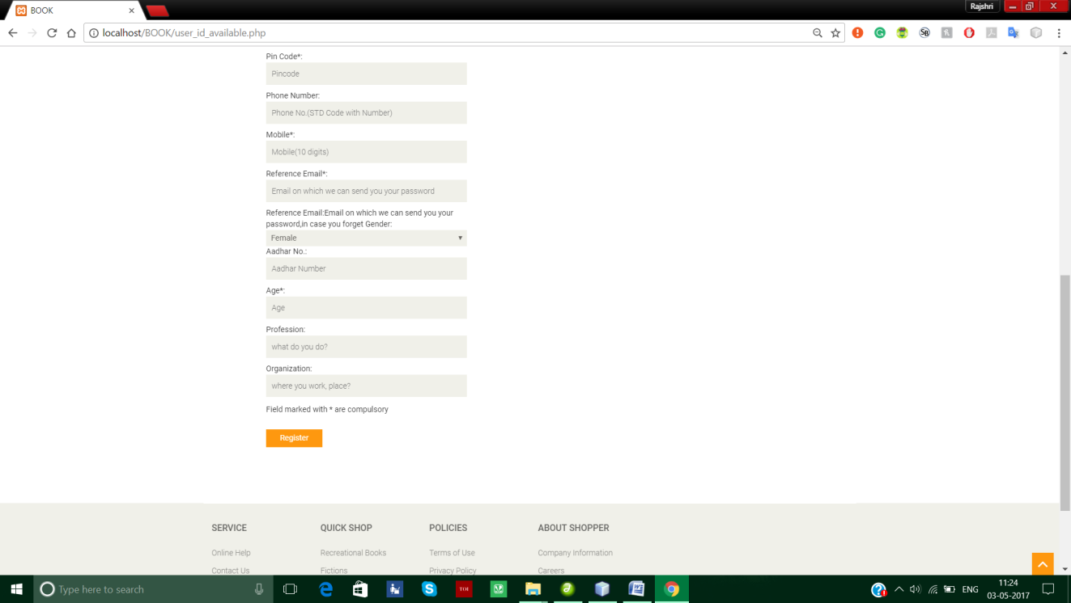
register

Slide 20
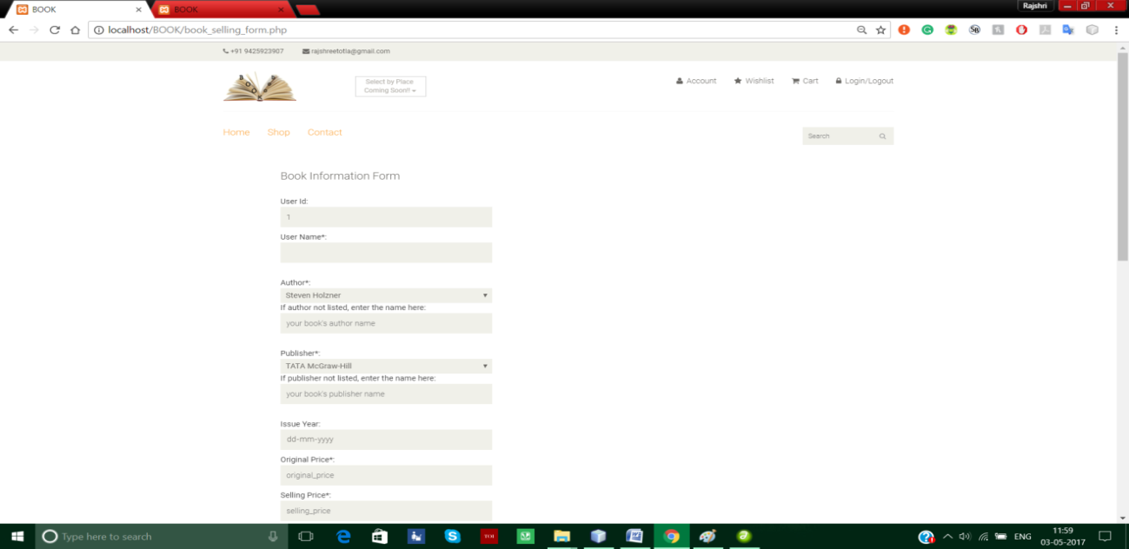
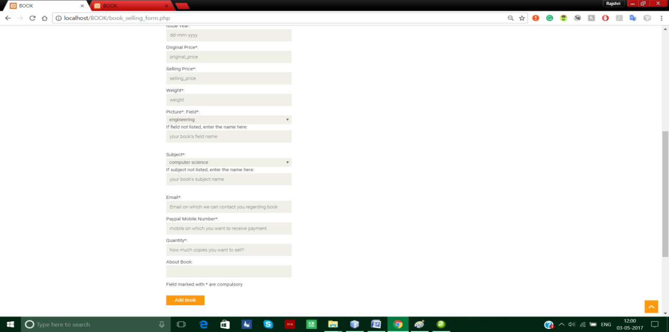
Book selling form

Slide 21
Limitations
Third party proprietary software for transaction
Cookies use
Drop down menus
Password encryption

Slide 22
Future scope
Introduction of review system
Transaction system development
Notifying users through email and message
CAPCHA feature

Slide 23
conclusion
Electronic shopping generates new business opportunities and for the customer
Provide the user with easy navigation, retrieval of data and necessary feedback as much as possible
Web app that can be used to buy books online
Helped in understanding the creation of an interactive web page and the technologies used to implement

Slide 24
References
https://www.w3schools.com/php/ for learning php
https://www.tutorialspoint.com/php/php_and_mysql.htm for database connectivity in php
https://www.w3schools.com/php/php_forms.asp for handling forms in php
https://www.w3schools.com/php/php_mysql_intro.asp for database connectivity in php
https://www.apachefriends.org/index.html for xampp information
https://www.youtube.com/watch?v=hdnUCjmJPb8 to learn using db on XAMPP
https://www.reference.com/technology/e-commerce-websites-69e627b633e85d3c
https://www.dynamicwebs.com.au/tutorials/e-commerce.htm

Slide 25
Thank you

